Slide 1
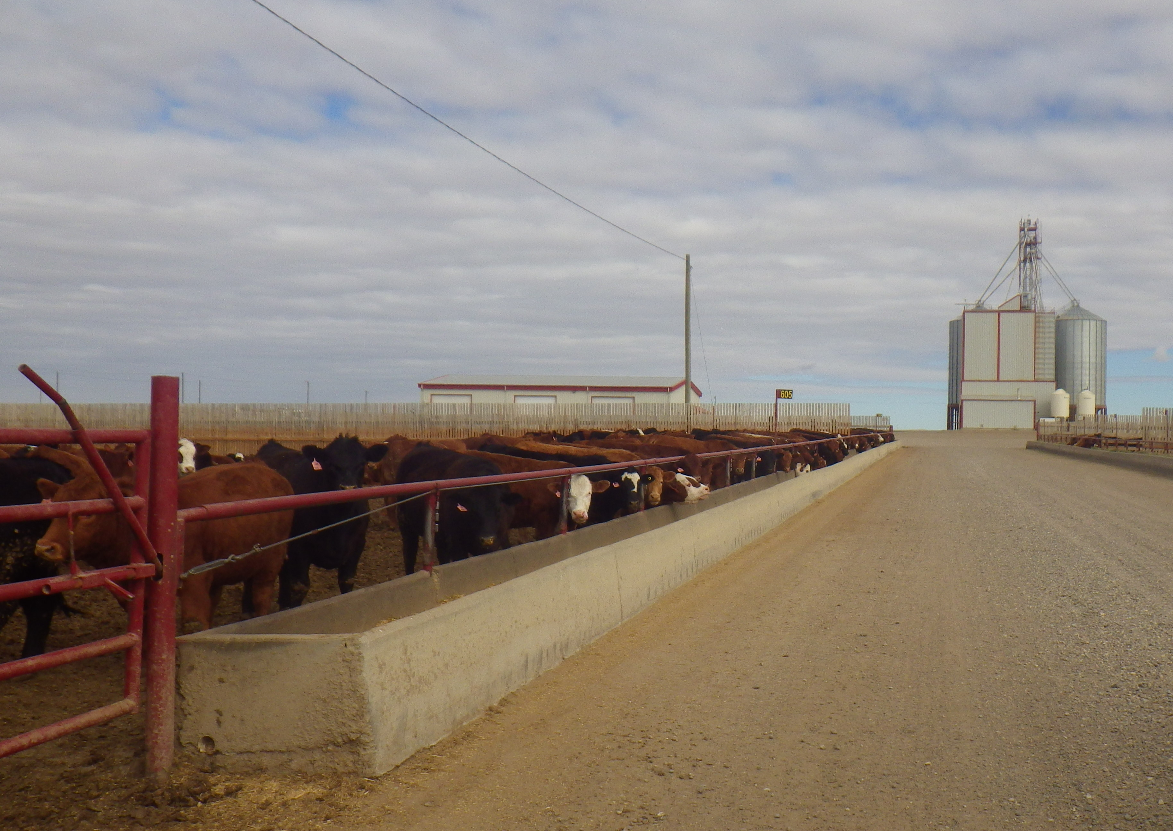
The Ongoing Battle with Histophilosis in Feedlot Cattle
Joyce Van Donkersgoed
DVM, MVS

Slide 2
Occurrence
caused by the bacteria Histophilus somnus
found in upper respiratory and genital tract of healthy cattle – commensal, opportunistic
many different strains; virulence
survives in and kills macrophages and PMNs
infection via nasal secretions or urine
variable environmental survival in blood/mucus (biofilm in water bowls)
invades lung and blood stream, infecting multiple organs
most common in fall placed calves, but also seen in winter placed calves and fall placed yearlings
generally seen after cattle on feed for 3-6 weeks
significant cause of mortality in calves, underdiagnosed
$$ losses
environmental impact

Slide 3
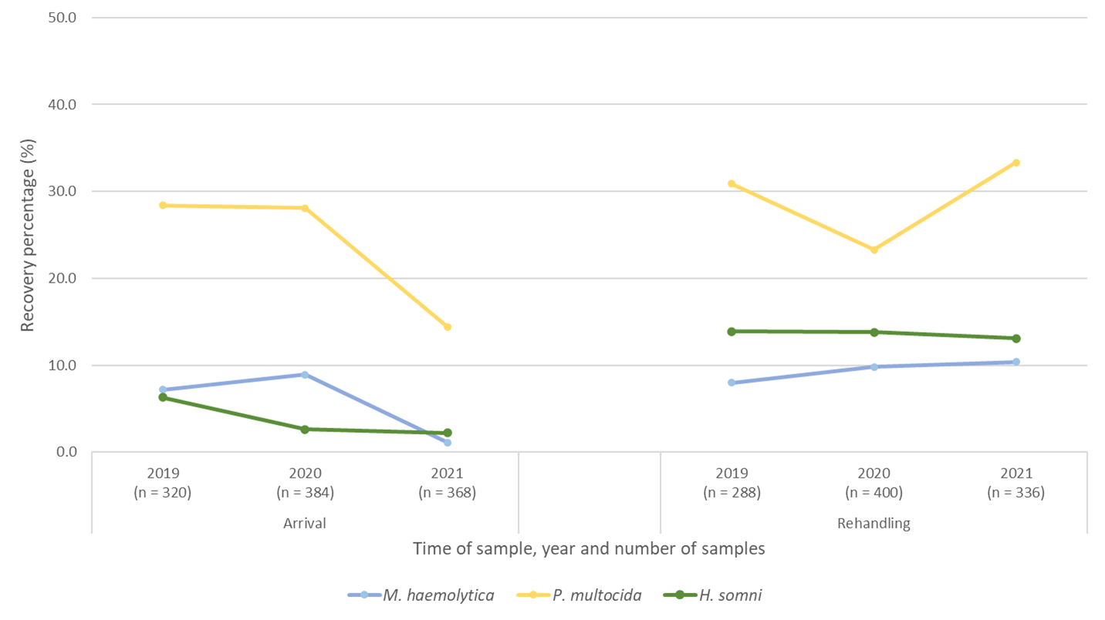
National Feedlot AMU/AMR Surveillance Program – 2019 to 2021 Nasopharyngeal isolation recovery rates (%)
Rehandling ~ 60 DOF

Slide 4
Histophilosis disease syndromes
Bovine Respiratory Disease (BRD)
Bronchopneumonia
Pleuritis
Laryngitis (wheezer)
Ear infections (otitis)
Nervous Disease
ITME (Sleeping Sickness)
Heart problems
Myocarditis
Pericarditis
Endocarditis
Lameness
Polyarthritis and tenosynovitis
Abortion

Slide 5
Causes of mortality in 10,000 head yard feeding predominantly fall placed calves

Slide 6
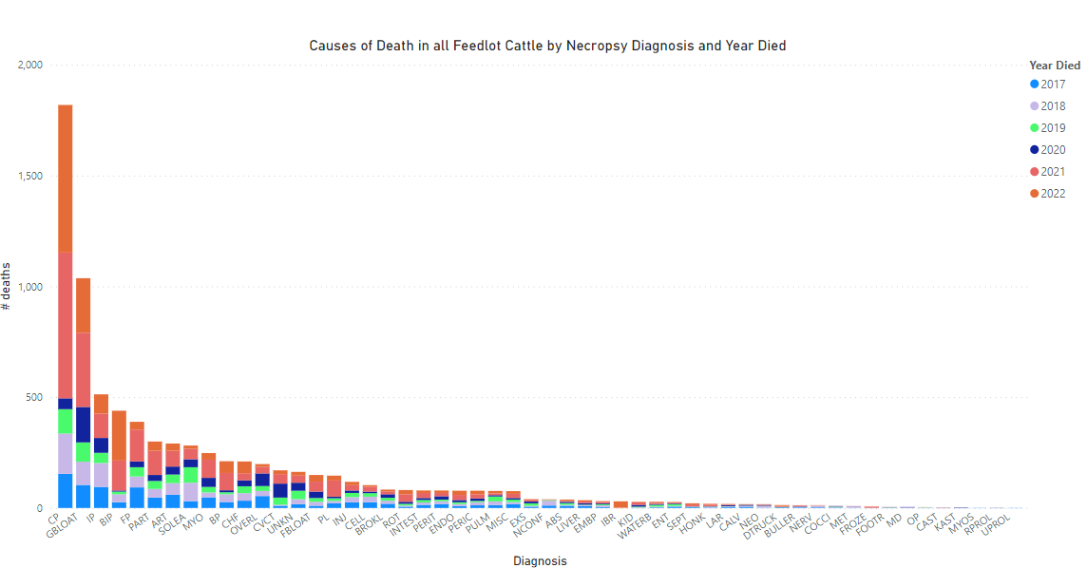
Multiple yards with 120,000 head capacity annually – feeding all types of cattle. Caused by H. somnus

Slide 7
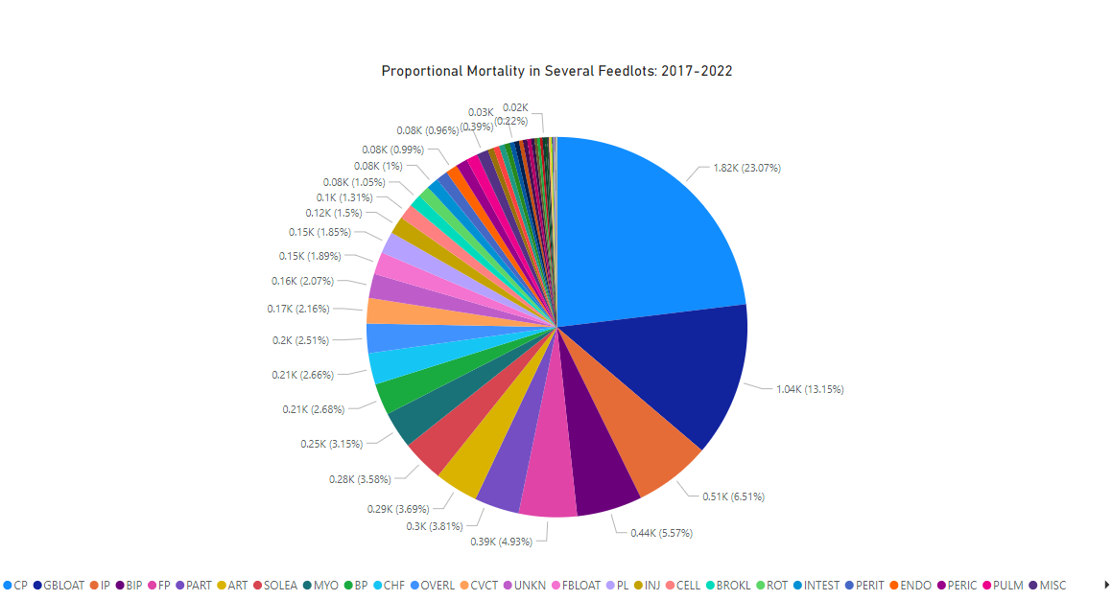

Slide 8
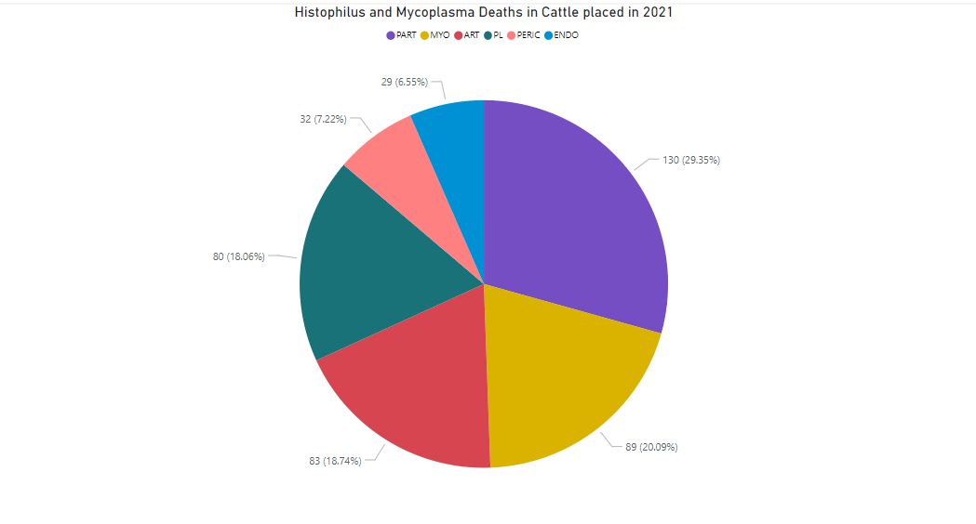
Multiple large feedlot operations in Alberta – often more than 1 system involved

Slide 9
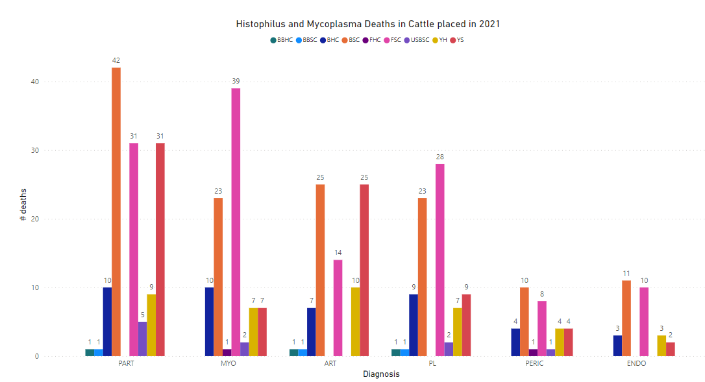

Slide 10
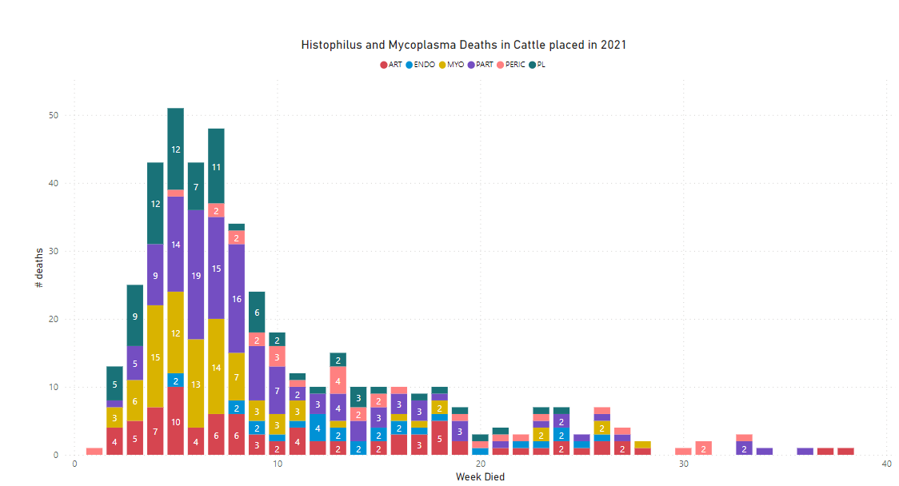
Occurrence of disease questions value of revaccination > 70 DOF since past largest risk period

Slide 11
Mortality occurrence in several Alberta feedlots over a 1 year period.

Slide 12
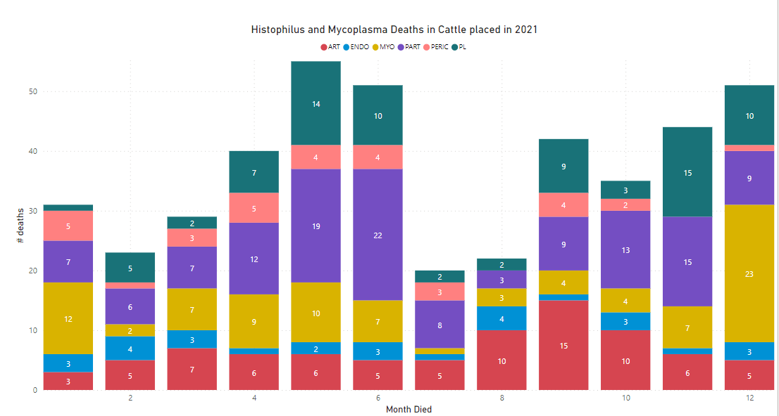
Cold weather stressor that precipitates?

Slide 13
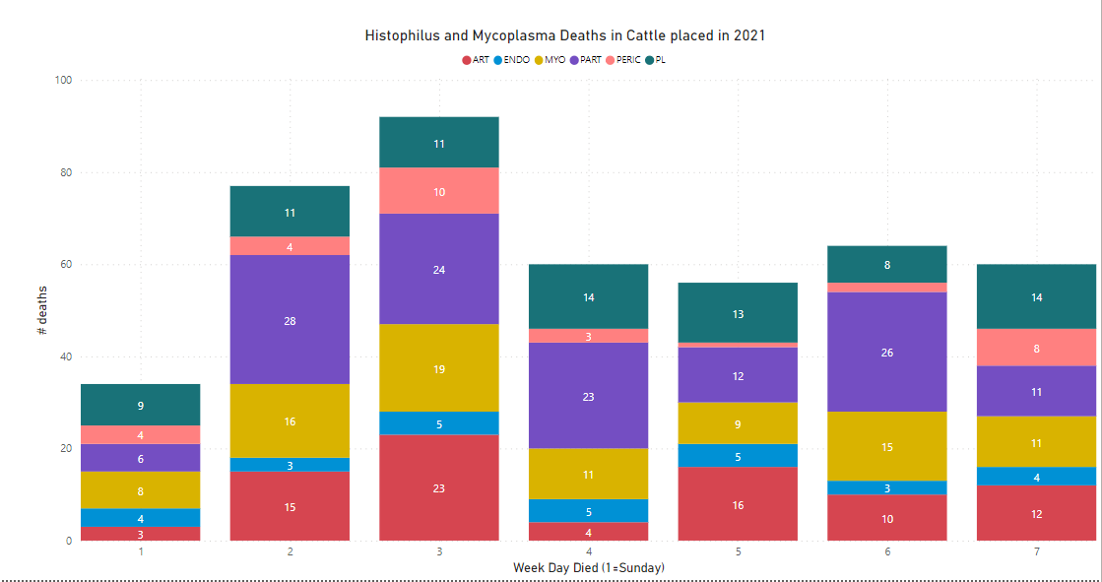

Slide 14
Pneumonia
causes bronchopneumonia or pleuritis
slow moving
depressed
off feed
+/- nasal discharge
+/- cough
respiratory breathing changes
fever (usually not too high if just histophilus infection e.g., 104-104.5 F)
stand alone

Slide 15
Laryngitis
snore when breathing in
+/- pneumonia signs

Slide 16
Bronchopneumonia
Laryngitis
Anterior-ventral lung lobes dark red and firm to touch
Yellow dead tissue on voice box

Slide 17
Myocarditis/Pericarditis
dead in pen
slow moving in pen and alleyway – may die as move to barn
may show severe respiratory distress (difficulty breathing, frothing or foaming at the mouth, open mouth breathing)
some may survive for some time and show signs of chronic heart failure (swelling under chin and brisket), but these C/S uncommon
previous history often indicates treated for UF/NF a week previously
improve diagnostics of heart damage?
Troponin
EPS (biofilm)

Slide 18
Heart Failure or Pleuritis
Extreme exercise intolerance – doesn’t want to move,
May mouth breathe and foam at mouth prior to death

Slide 19
Peracute myocarditis – acute hemorrhages in heart muscle – die before show signs of heart failure, like fluid in the lungs

Slide 20
Heart failure from acute myocarditis
When open chest, typically see enlarged, heavy wet lungs, with interstitial edema (fluid) and hemorrhage.
Sometimes misdiagnosed as CHF if don’t check heart muscle carefully.

Slide 21
Myocarditis (infection of heart muscle)
Chronic – scar tissue with abscess in papillary muscles
Acute – red hemorrhages in papillary muscle of heart – 24 to 48 hours old

Slide 22
Miliary myocarditis in severe bacterial infections – multiple small abscesses in heart muscle

Slide 23
Pericarditis (infection of heart sac)

Slide 24
Pleuritis (infection on lung surface)
Usually lung collapsed underneath the yellow fibrin and lung tissue normal – die of suffocation

Slide 25
ITME (Sleeping Sickness)
occurrence not as common as in mid-80s, probably due to metaphylaxis on arrival and feed medications, but outbreaks or individual cases may still occur
often seen 3-4 weeks post-arrival, but can be observed at any time
early signs
back feet knuckle, weak, depressed
later signs
down on their side, head back (opisthotonos – can raise head but not get up), may paddle with legs, eyes might roll in eyelid (nystagmus)
found dead in pen

Slide 26
ITME – Sleeping Sickness
Opisthotonus – head back
Nystagmus (eye rolls in head)

Slide 27
ITME –Infectious Thrombomeningoencephalitis – Sleeping Sickness
Photo courtesy of Dr. Ted Clark – multiple hemorrhages in the brain.

Slide 28
Arthritis
lame
3-8 weeks post-arrival
swelling of joints – mainly large joints like the stifle (most common), hocks, occasionally shoulder, elbow, knee
multiple joints often infected (polyarthritis)
tenosynovitis
+/- pneumonia signs

Slide 29
Arthritis (stifle)

Slide 30
Arthritis (infection of joints)

Slide 31
Treatment
treat with antimicrobials as per vet’s health protocol
treat pneumonias as BRD (UF/NF)
treat ITME as nervous disease
moderate response if treat early
need antimicrobials that penetrate the brain
treat arthritis
moderate response, improves with longer treatment and NSAIDs
treat myocarditis?
history suggests often treated for UF/NF a week or so previously
once heart damaged, no cure

Slide 32
Antimicrobial Control
Chlortetracycline in-feed
1 gram/head/day for 56 DOF
research by FHMS and Lakeside suggested reduction in Hs mortality (prior to metaphylactic macrolides on the market)
pulse at 22 mg/kg body weight for 5 days at various time intervals (Zoetis research suggests cost: recovery for BRD) – no published evidence reduces histophilosis systemic forms
Long-acting oxytetracycline
mass pen treatment Day 8 or Day 11 or Day 17
reduced BRD treatment by 14% and BRD mortality by 71%, but not Histophilosis mortality
serological titers to Hs on arrival increased in nonvaccinated animals
those with lower HS titers on Days 1 and 96 had increased risk of BRD relapses or death from BRD + Histophilosis
Pulmotil in the feed?
Can Vet J Volume 35, September 1994
increasing tetracycline resistance (ICE)
genetic linkage with higher Cu and Zn MICs?

Slide 33
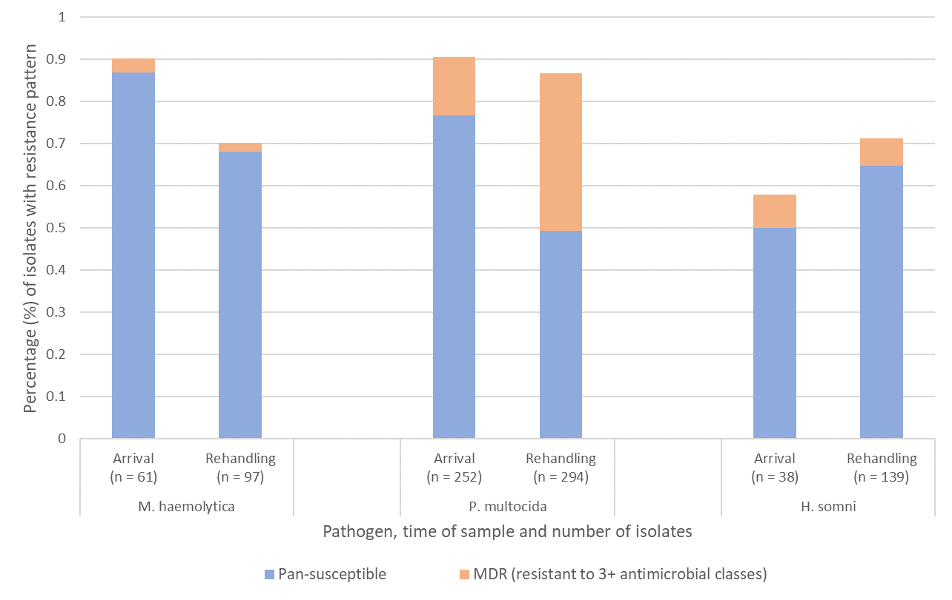
BRD pathogens, phenotypes of interest
Histophilus somnus
Arrival
Pan-susceptible: 50%
MDR: 8%
Rehandling (~ 60 DOF)
Pan-susceptible: 65%
MDR: 7%
Common patterns:
TET (7-15% in 2019-2021)
National Feedlot AMU AMR Surveillance Program – Nasopharyngeal Isolates from 2019 to 2021

Slide 34
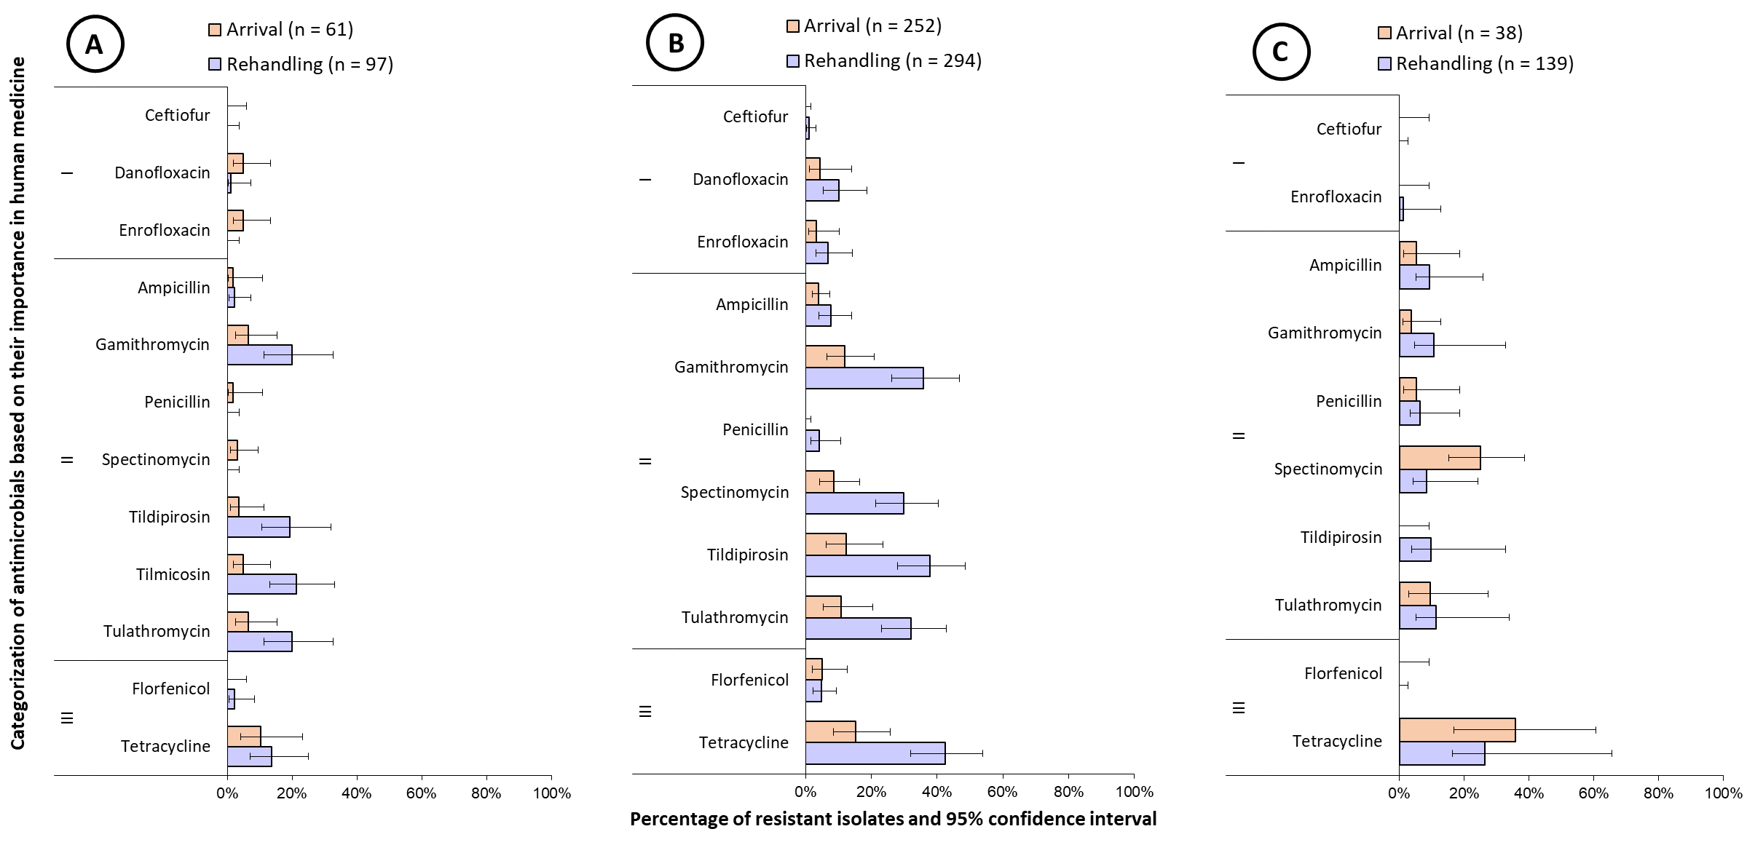
BRD pathogens, resistance prevalence
A = Mannheima haemolytica; B = Pasteurella multocida; C = Histophilus somnus
Zactran
No test for tilmicosin (Micotil)
Zuprevo
Draxxin
Do lab test results of antimicrobial sensitivity from select nasal isolates relate to AM therapeutic effectiveness in the field?

Slide 35
Prevention
Vaccinate with Histophilus somnus vaccine?
current vaccines are killed whole cell antigens (Somnugen®, Somnubac®, HIPRABOVIS® SOMNI/LKT, Somnus™)
effectiveness of current vaccines against bronchopneumonia, laryngitis, myocarditis, pericarditis, pleuritis, and arthritis prevention in feedlot cattle not proven
Ribble CVJ 1988 – no impact on total mortality; steers double vaccinated reduced mortality if nonHS deaths removed
Controlled field vaccine trial at Clavelle’s feedlot – no vaccine effect - not published
old killed bacterins were built originally for ITME (sleeping sickness). HIPRA bacterin for BRD
No published current scientific data from controlled feedlot trials in commercial yards in N America to indicate any bacterins cost-effectiveness in reducing histophilosis
recent research suggests killed whole cell Histophilus somnus bacterins may enhance disease – endotoxins and production of IgE antibodies
antigenic overload at feedlot entry?
new research – intranasal 3-way MLV vaccine increased Hs in upper respiratory tract

Slide 36
Vaccine Research Needed
many different strains of bacteria
cross protection amongst strains?
strain differences cause different lesions?
UC Davis 2016 – subunit vaccine
Experimental respiratory challenge with focus on pneumonia prevention
VIDO 2015 – subunit vaccine
focus on multi-systemic form
autogenous bacterin effectiveness?
need support from Canadian beef cattle industry to continue HS subunit vaccine research at VIDO to build an effective vaccine to prevent histophilosis
Problem for commercialization – not perceived a big issue in the USA – don’t look, don’t find!!

Slide 37
Acknowledgments
Dr. Janzen
Photos/videos

